Slide 1
Data Reply 2
A restaurant recommender system

Slide 2

Meet John
Meet John – John is a food fanatic.
John has been to many restaurants in the past and would love to explore new ones!
Problem: The restaurant reviews that John sees, aren't based on people with a similar taste to John.
Our solution: To help John find the perfect restaurant with the reviews of similar users .

Slide 3
Our approach
Finding out what our recommendation system will be based on by exploring different datasets
Creating the recommendation system beneficial and useful towards a specific audience
01
02
03
04
Understanding and analysing the information in our dataset, to see if it’s appropriate to use for our recommendation system
Further recommendations for the system

Slide 4
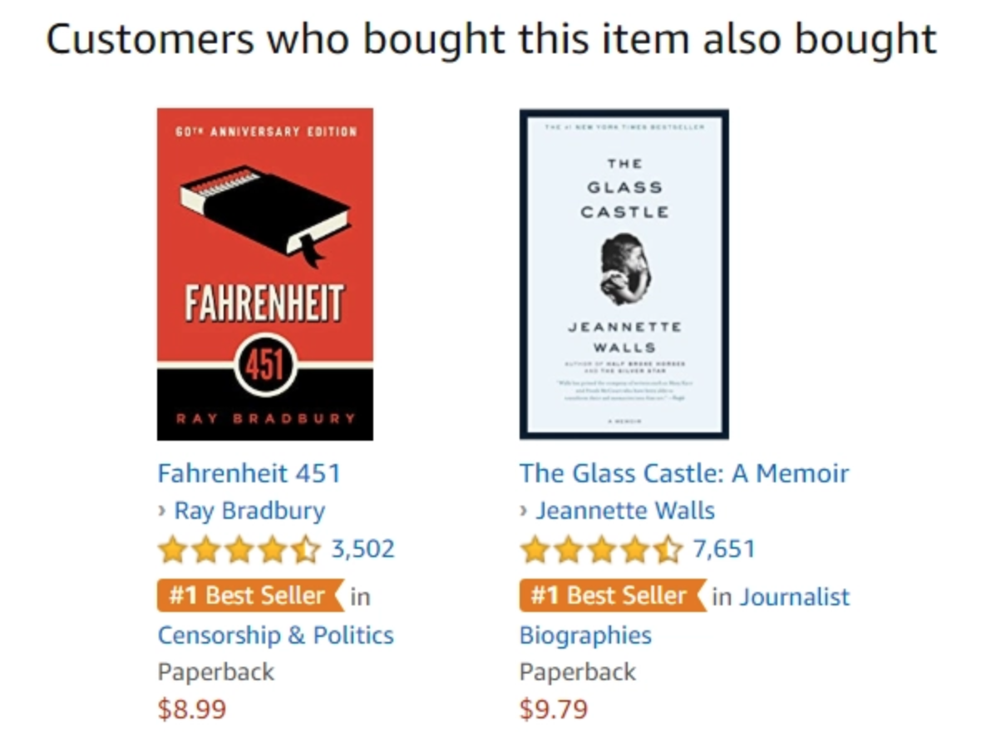
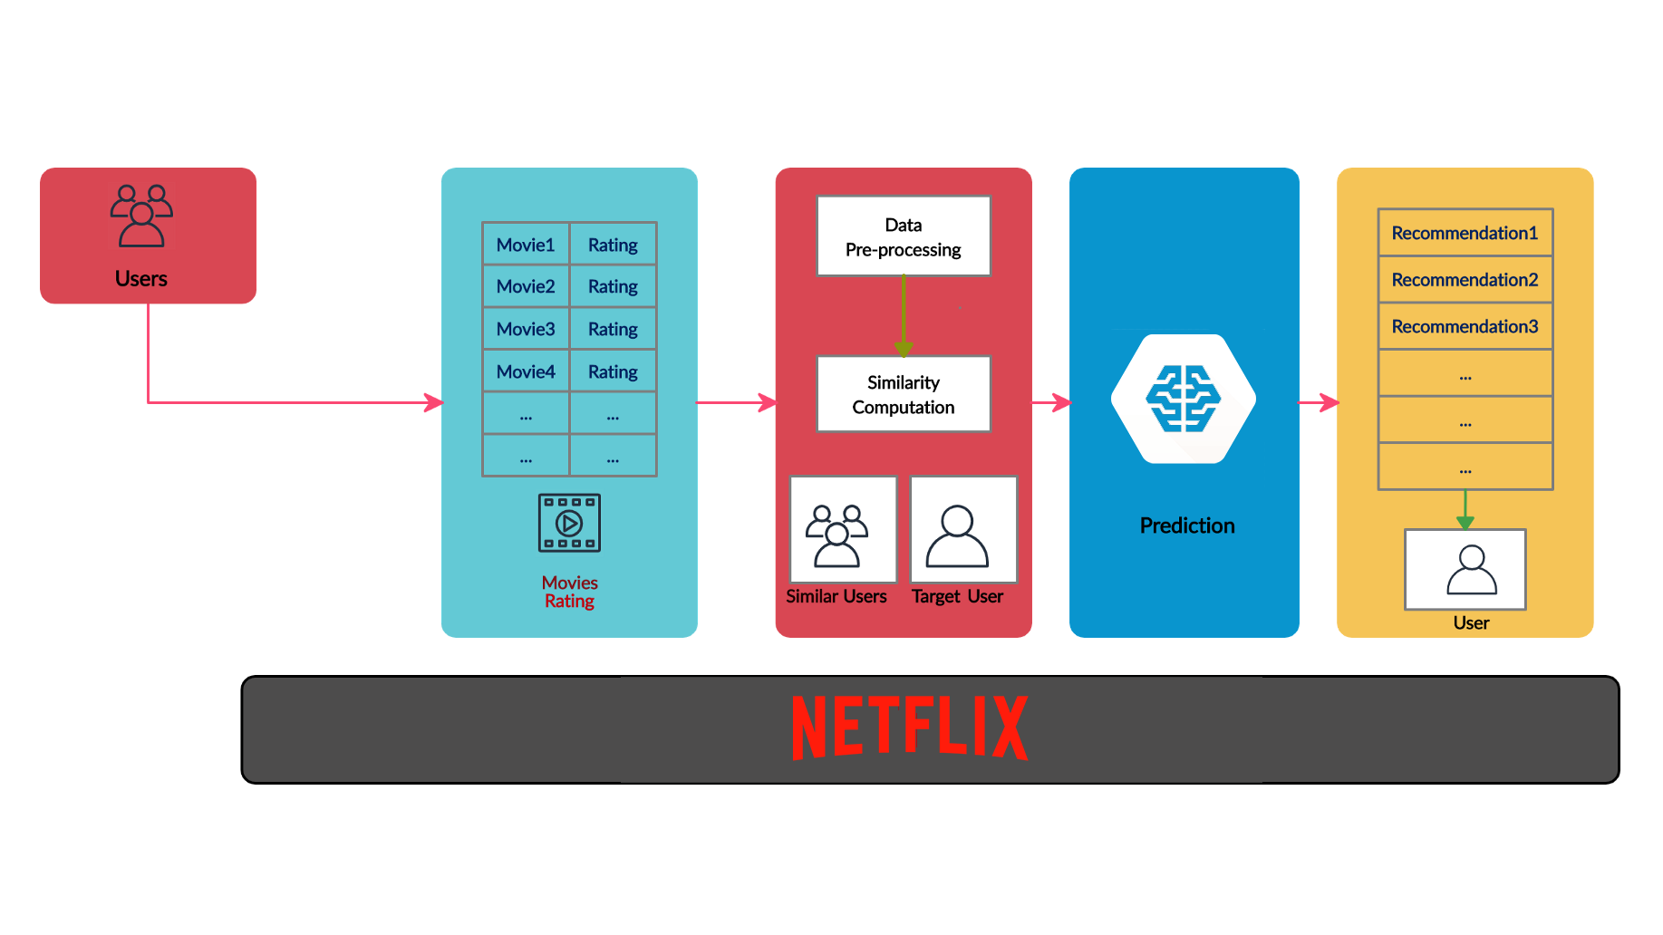
Recommender system
01
02

Slide 5

Dataset-
Background
Restaurant ratings
.
Dataset 1
Dataset 2
Restaurant attributes
Generate a top-n list of restaurants according to the consumer preferences and finding the significant features
Source: Kaggle

Slide 6
Dataset 1 –
Restaurant ratings
 | userID | placeID | rating | food_rating | service_rating
0 | U1077 | 135085 | 2 | 2 | 2
1 | U1077 | 135038 | 2 | 2 | 1
2 | U1077 | 132825 | 2 | 2 | 2
Number of records: 1161
Number of restaurants: 130
Number of users: 138
Number of fields: 5

Slide 7
Dataset 2 –
Restaurant attributes
 | placeID | latitude | longitude | the_geom_meter | name | address | city | state | country
0 | 134999 | 18.915421 | -99.184871 | 0101000020957F000088568DE35671… | Kiku Cuernavaca | Revolucion | Cuernevaca | Morelos | Mexico
1 | 132825 | 22.147392 | -100.983092 | 0101000020957F00001AD016568C4… | Puesto de tacos | Esquina santos degollado y leon guzman | s.l.p. | s.l.p. | Mexico
2 | 135106 | 22.149709 | -100.976093 | 0101000020957F0000649D6F21348… | El Rincon de San Francisco | Universidad 169 | San Luis Potosi | San Luis Potosi | Mexico
3 | 132667 | 23.752697 | -99.163359 | 0101000020957F00005D6BCDDED81… | Little pizza Emilio Portes Gil | Calle Emilio portes gil | Victoria | tamaulipas | ?
4 | 132613 | 23.752903 | -99.165076 | 0101000020957F00008EBA2D06DC8… | Carnitas_mata | Lic. Emilio portes Gil | Victoria | tamaulipas | Mexico
*5 rows x 21 columns
Number of records: 130
Number of fields: 21
Feature used: placeID

Slide 8
Results
1
Smarter Recommendations
3
Better Customer Experience
2
Increase in Sales

Slide 9
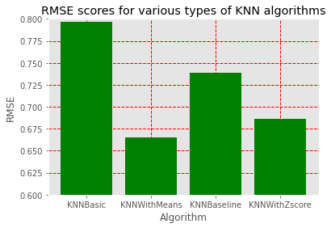
Choosing the Base Model
The lower the score the better
KNNWithMeans wins. A memory based algorithm which also factors in average ratings in-order to eliminate bias.
E.g. certain users rate more harshly than others so this would be scaled to make it fair

Slide 10
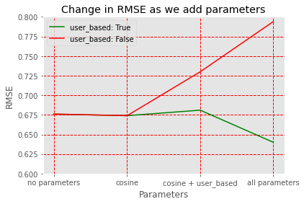
Fine Tuning the Model
Green line is the combination of parameters we went with.
Green line shows adding user-based option has slightly negative impact, but red line demonstrates how much worse it is without, so overall it is positive.
Adding these parameters, together, makes the model more accurate

Slide 11
Results
Choice |  | Result
Base model |  | KNNWithMeans
User based/Item based |  | User based
Minimum support |  | 9
Similarity measure |  | Cosine
19.7% increase in accuracy from the base model to out final model
Significant decrease in errors as illustrated below
Increased accuracy in predictions
Users receive recommendations that are more likely to be what they like
This leads to increase in sales and a better customer experience

Slide 12

Google Recommend – Google Reviews
The first step is information retrieval – the reviews are collected from users
It is a traditional approach
At the end, customers are recommended their choice of restaurant
Users are not connected to each other – they cannot communicate with each other

Slide 13
Commercial viability
The Google homepage has a section for personalized restaurant recommendations.
The pay per click (PPC) is more optimized as restaurants on Google can reach out to more relevant customers.
Businesses benefit from organic growth as customers interested in their products are brought to their site.
Small restaurants with a smaller number of reviews have better outreach on Google.

Slide 14

Social media restaurant recommender
It is a more modern approach
Essentially gives a visual representation to users rather than traditional written reviews on google.
Data is collected of users who interact with restaurant reviews on google e.g., place id, and rating.
Connects users to posts and other user profiles who reviewed same restaurants
Users who share the restaurant id on social media are essentially feeding the algorithm with data.
E.g. Instagram users will be recommended profiles that tagged restaurant in posts or stories.

Slide 15

Commercial viability
Personalized user experience i.e., Better Instagram explore page results.
Leads to a new purpose for Instagram and less companies hiring media marketing agencies to attract customers.
Advertisements are a hit or miss with each user it's promoted to.
The recommender in social media would be able to passively promote restaurants that are more specific to a user rather than general niches.

Slide 16





Meet the team
An – Data Analyst
Adam – Data Scientist
Arish – Project Leader
Jameelah – Data Analyst
Josh – Data Analyst

Slide 17
Thank you for listening
Any questions?

